Slide 1
Lecture 9
Introduction to Weka (II)

Slide 2
Introduce Dataset
The data is related with direct marketing campaigns of a Portuguese banking institution.
The marketing campaigns were based on phone calls. Often, more than one contact to the same client was required, in order to access if the product (bank term deposit) would be (or not) subscribed.

Slide 3
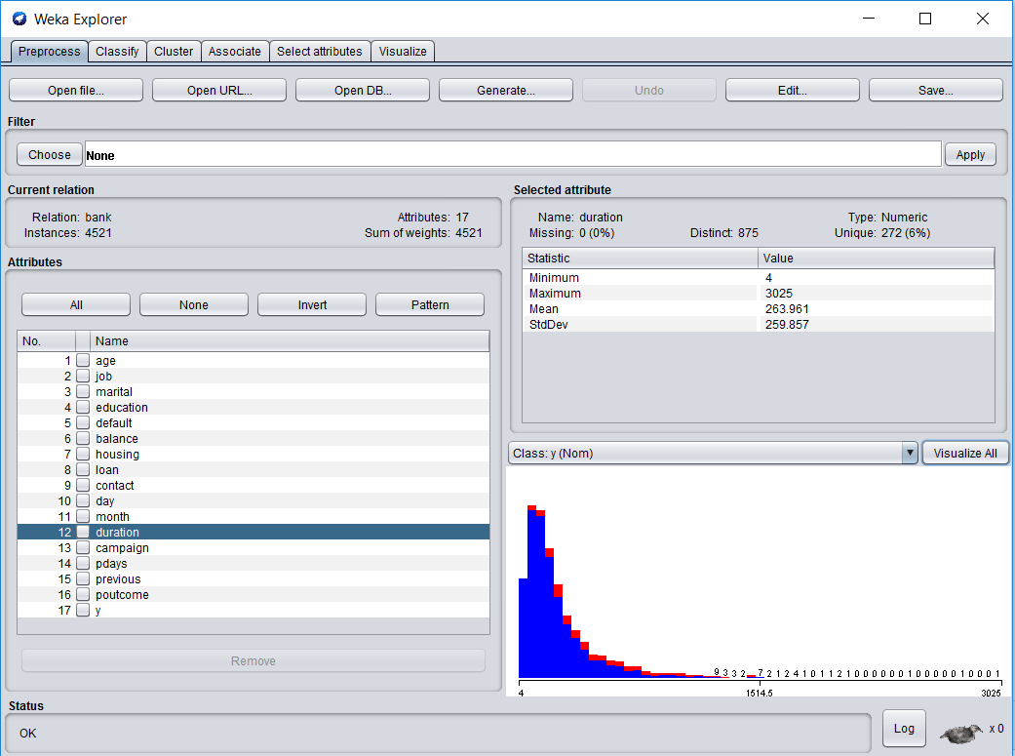
Preprocess
Choose the dataset and modify it in various ways

Slide 4
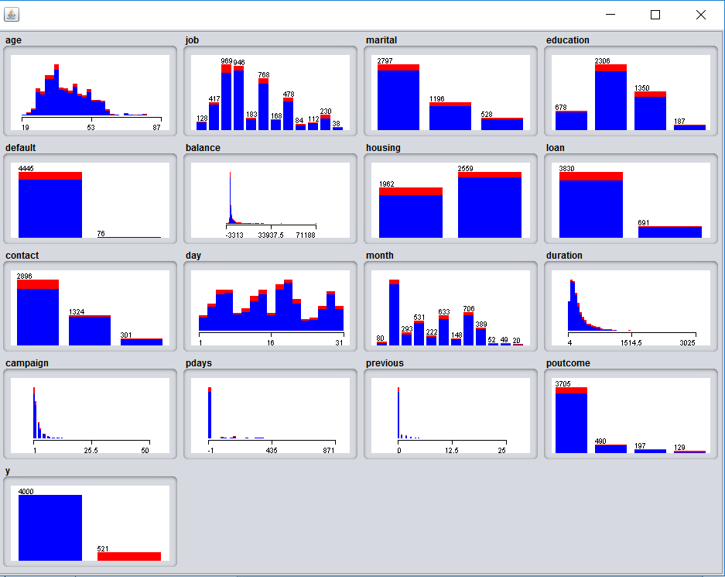
Preprocess 2
Histogram to show all the attributes range.
Red is no, Blue is yes

Slide 5
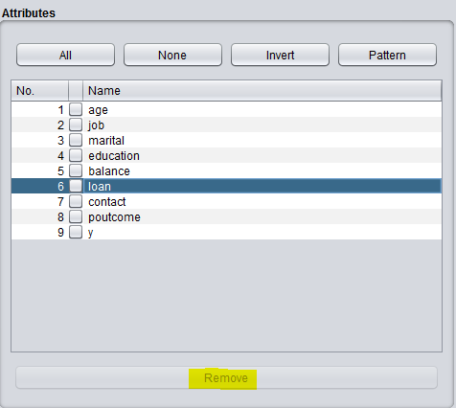
Preprocess 3
Remove attribute, simplest way to lower dimension of attributes

Slide 6



Preprocess 4
you might want to eliminate the outlier and extreme data (eliminate the smallest and biggest):
  IRQ (extreme factor :6Ó; outliner factor:3Ó)
  Remove with Values: remove the outlier and extreme data(labeled with yes).

Slide 7
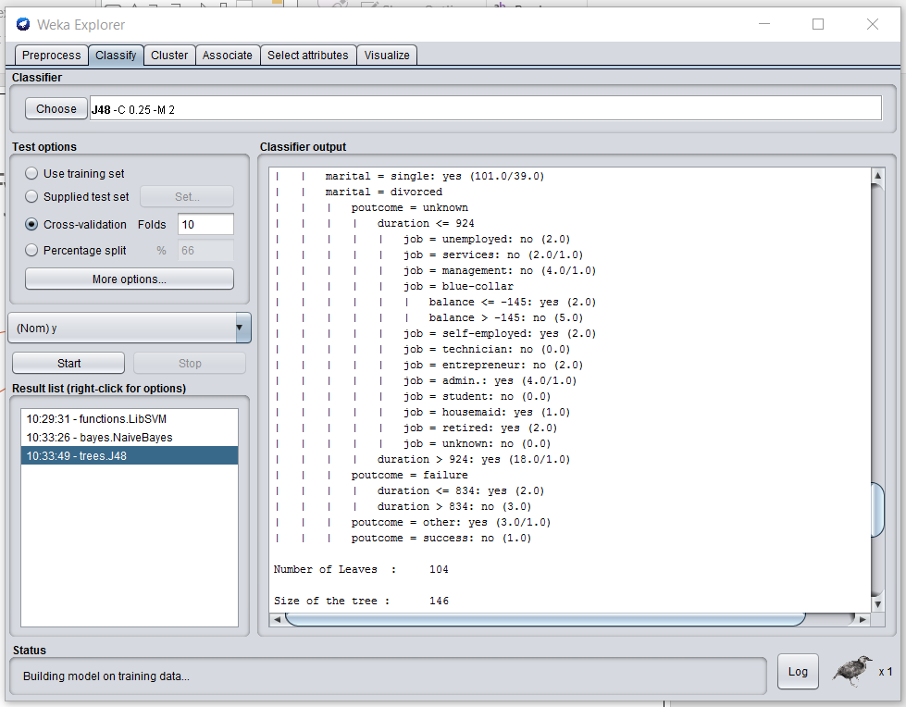
Classify
Train learning schemas that perform classification or regression and evaluate them

Slide 8
Classification
Predicted target must be categorical
Implemented methods
  decision trees(J48, etc.) and rules
  Naïve Bayes
  neural networks
  instance-based classifiers …
Evaluation methods
  test data set
  Cross validation
Demo data: iris, contact lenses, labor, soybeans,etc.

Slide 9
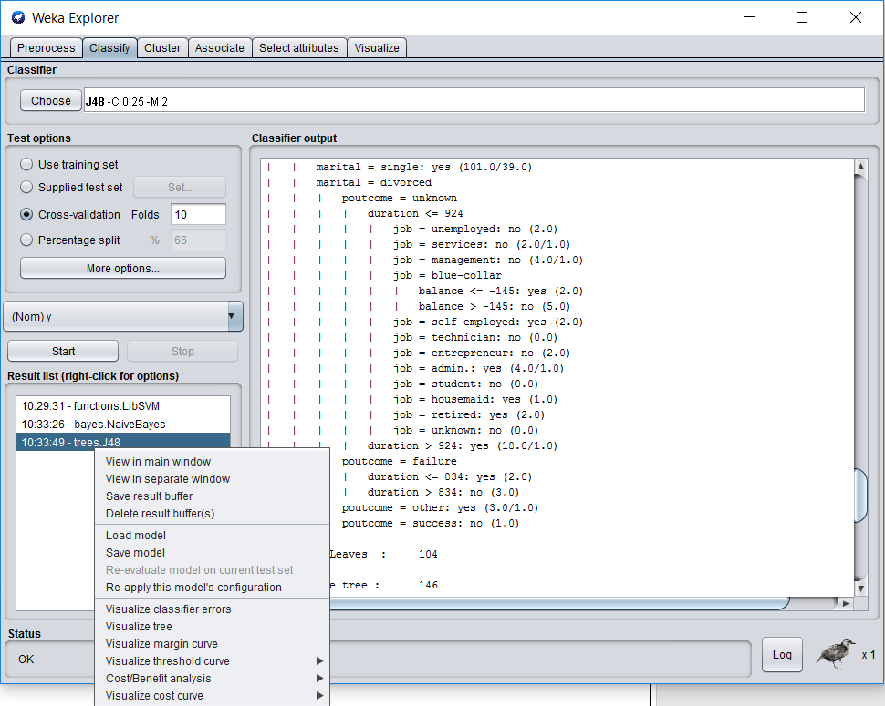
Save/load the model
Save Model for the other dataset.
Or load Model for apply it.

Slide 10
Understand the meaning of model
TP = true positives: number of examples predicted positive that are actually positive
FP = false positives: number of examples predicted positive that are actually negative
TN = true negatives: number of examples predicted negative that are actually negative
FN = false negatives: number of examples predicted negative that are actually positive
Eg:
=== Confusion Matrix === also called contingency table
a(no) b(yes) <-- classified as
3160(TN) 86(FN) | a = no
236(FN) 86(TP) | b = yes
Original data: a(no) 3160+86=3246 b(yes) 236+86=322

Slide 11
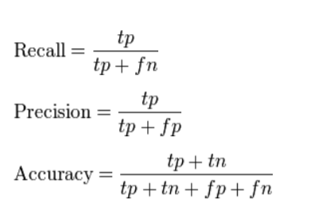
Understand the meaning of model
TP Rate: rate of true positives (instances correctly classified as a given class)
FP Rate: rate of false positives (instances falsely classified as a given class)
Precision: proportion of instances that are truly of a class divided by the total instances classified as that class
Recall: proportion of instances classified as a given class divided by the actual total in that class (equivalent to TP rate)

Slide 12

Understand the meaning of model
F-measure : A measure that combines precision and recall which is the harmonic mean of precision and recall, the traditional F-measure or balanced F-score:

Slide 13
Understand the meaning of model
Mean absolute error (MAE): measures the average magnitude of the errors in a set of forecasts, without considering their direction. It measures accuracy for continuous variables. The MAE is a linear score which means that all the individual differences are weighted equally in the average;
Root mean squared error (RMSE) : measures the average magnitude of the error; The difference between forecast and corresponding observed values are each squared and then averaged over the sample.
The MAE and the RMSE can be used together to diagnose the variation in the errors in a set of forecasts.
The RMSE will always be larger or equal to the MAE;
the greater difference between them, the greater the variance in the individual errors in the sample. If the RMSE=MAE, then all the errors are of the same magnitude

Slide 14
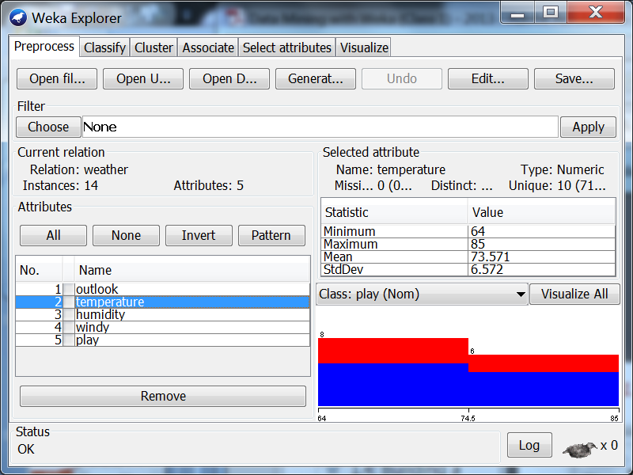
Cluster
Learn clusters for the dataset

Slide 15
Clustering
Implemented methods
  k-Means
  EM
  Cobweb
  X-means
  FarthestFirst…
Clusters can be visualized and compared to “true” clusters (if given)
Demo data:
  any classification data may be used for clustering when its class attribute is filtered out.

Slide 16
Associate
Learn association rules for the data and evaluate them

Slide 17
Select Attributes
Select the most relevant aspects in the dataset

Slide 18
Visualize
View different two-dimensional plots of the data and interact with them

Slide 19
Pre-processing the data
Data can be imported from a file in various formats: ARFF, CSV, C4.5, binary
Data can also be read from a URL or from an SQL database (using JDBC)
Pre-processing tools in WEKA are called “filters”
WEKA contains filters for:
  Discretization, normalization, resampling, attribute selection, transforming and combining attributes, …

Slide 20
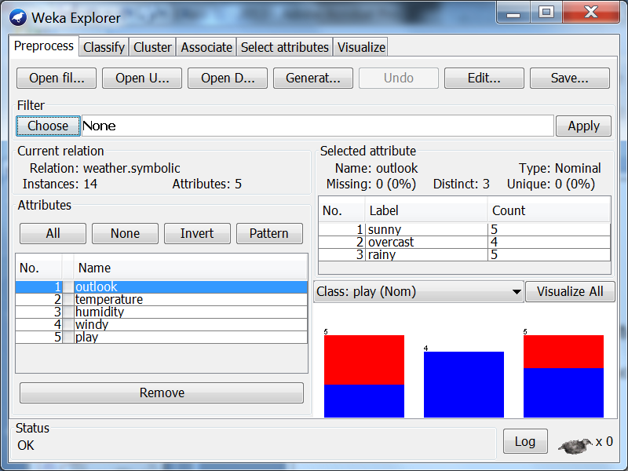
Filter
Filters can be used to change data files
  Use a filter to remove an attribute
    Open weather.nominal.arff
Click

Slide 21
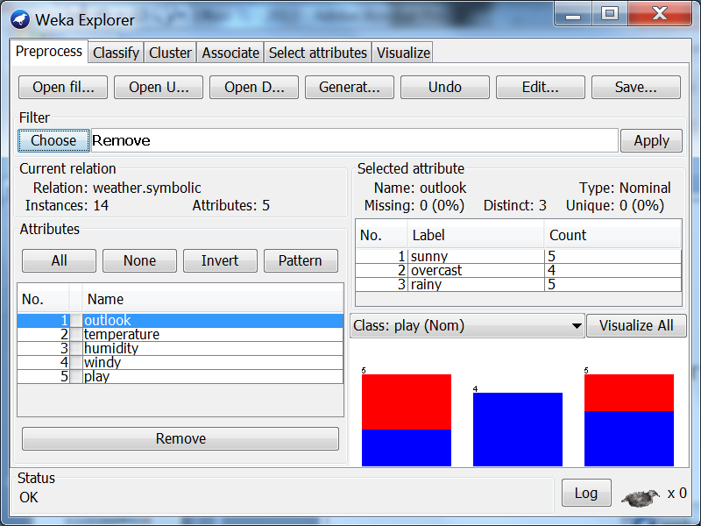
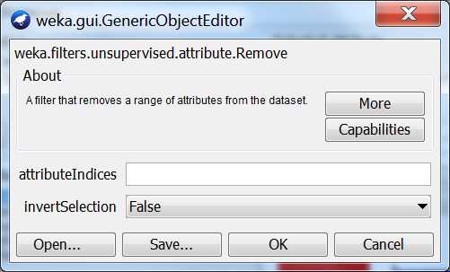
Using a Filter to Remove an Attribute
Choose the unsupervised attribute filter Remove

Slide 22
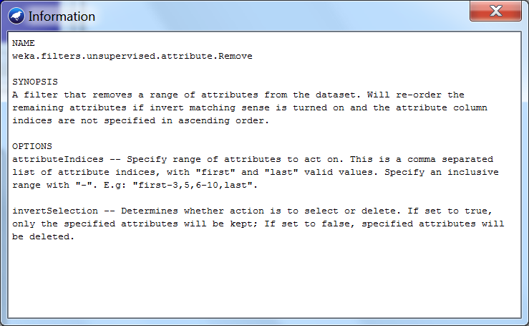
Using a Filter to Remove an Attribute
Check the More information

Slide 23
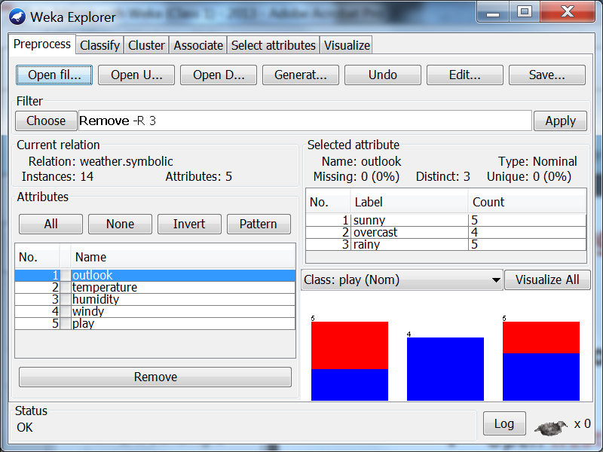
Using a Filter to Remove an Attribute
Set attributeIndices to 3 and click OK
R 3

Slide 24
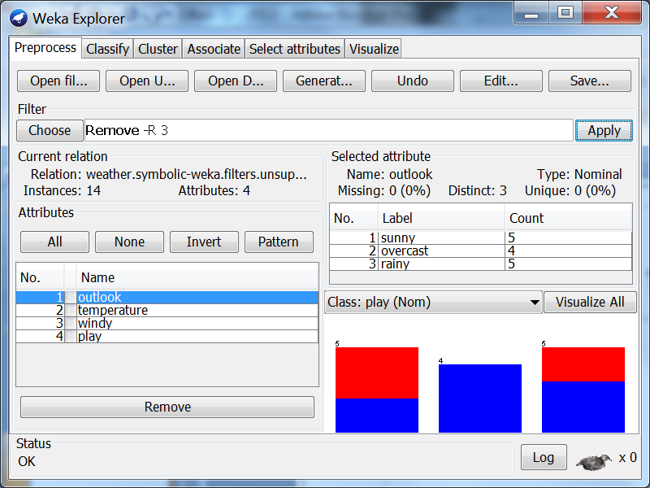
Using a Filter to Remove an Attribute
Apply the filter
you can Save the result
Press Undo

Slide 25
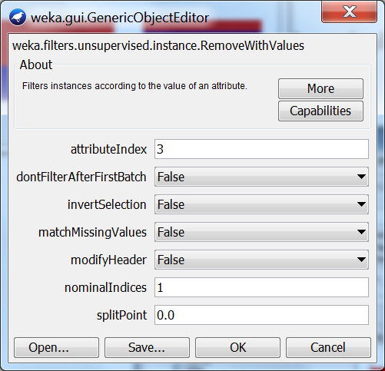
Use a Filter to Remove Instances
Select RemoveWithValues
  E.g., Remove instances where humidity is high
    Set attributeIndex 3
    Set nominalIndices 1

Slide 26
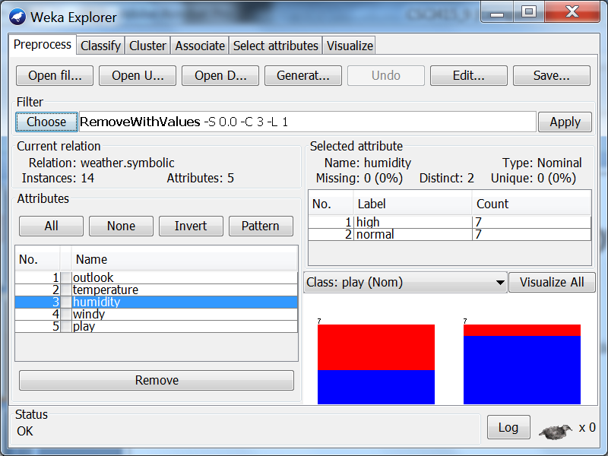
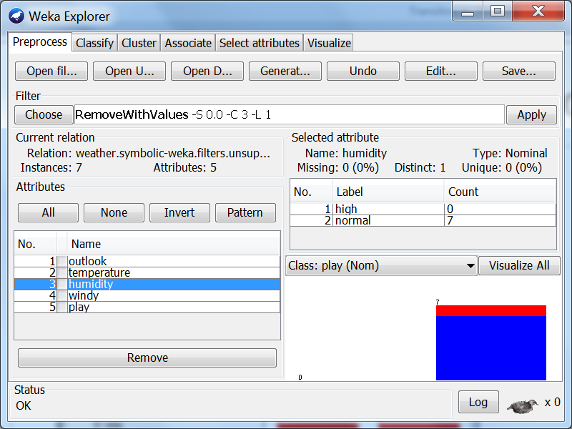
Use a Filter to Remove Instances
Apply the filter

Slide 27
Other Filters
Discretize: Discretizes a range of numeric attributes in the dataset into nominal attributes
  Example
  Do it now
NominalToBinary: Converts nominal attributes into binary ones, replacing each attribute with k values with k new binary attributes;
  Example
  Do it now
  …

Slide 28
Using Filter
Fewer attributes, better classification!
Example: Open glass.arff
  Run J48 (trees>J48)
  Remove Fe
  Remove all attributes except RI and MG
  Look at the decision trees
  Use right‐click menu to visualize decision trees

Slide 29
Filter
Filters in Weka
  Supervised vs unsupervised,
  attribute vs instance
To find the right one, you need to look!
Filters can be very powerful
Judiciously removing attributes can
  improve performance
  increase comprehensibility

Slide 30
Output: Text-based results
Run Information;
Summary of model;
Statistics of training data;
Predictions of test data;
Type of sampling;
Confusing Matrix;
Detailed Accuracy by class;
Entropy evaluation measures;
…

Slide 31
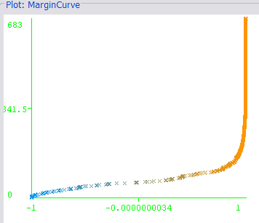
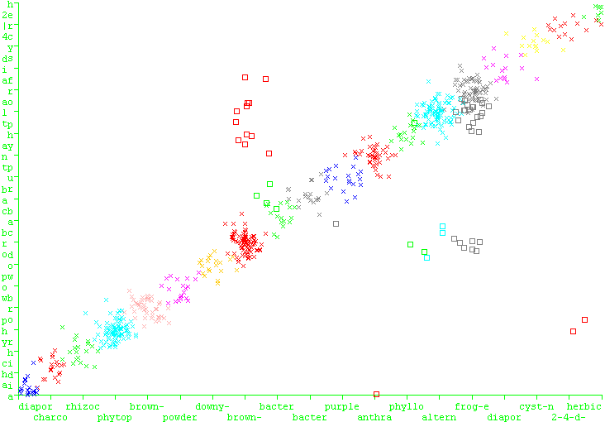
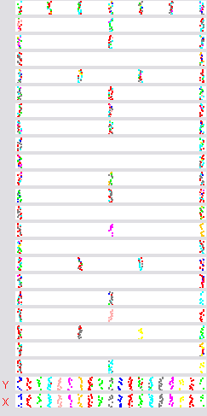
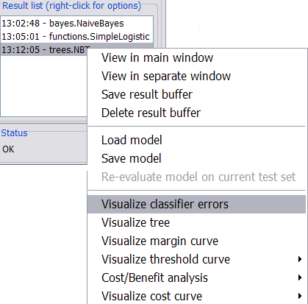
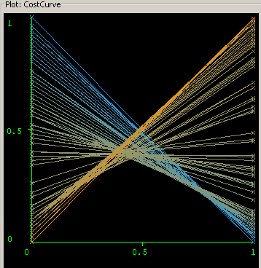
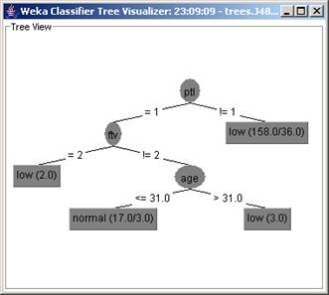
Output: Graphical-based results

